Slide 1
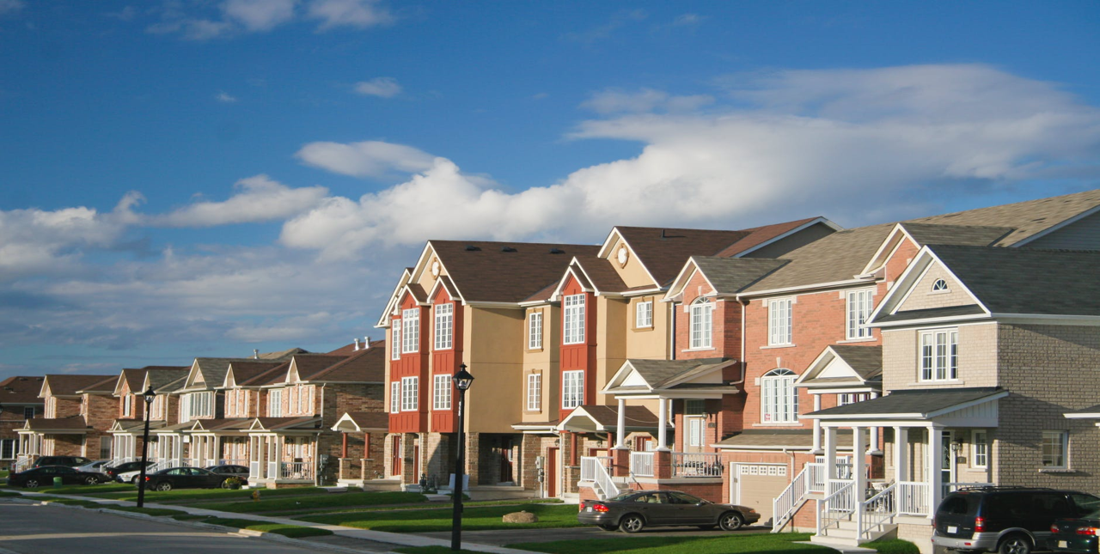
Capstone Project: Analysis of Home Price
Jisha Prakash Kuttassery
APRIL 2018

Slide 2
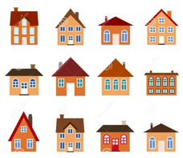
Topic: Questions of home buyers / owners
A house is the biggest purchase most people make in their lives, one they will pay off for years.
Based on the type of homes people prefer and their priorities of amenities in those homes answer the questions of new home buyers, sellers, remodelers and builders
What kind of houses sell for higher price?
Is my Property a good deal?
How to Improve home value?
Dataset
Data set - Kaggle’s, Iowa House Prices: Regression Techniques

Slide 3
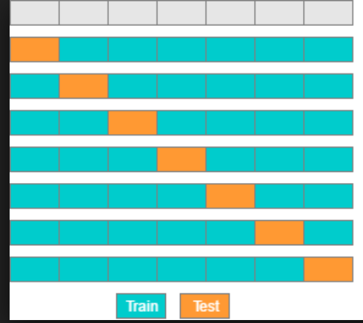
Overview of Data
Dataset contains 81 variables and 1461 observations. 23 nominal, 23 ordinal, 14 discrete, and 21 continuous.
The variables are basic characteristics of property and house.
Challenges
Dataset has NA’s and missing values.
Exploring the correlation of NA’s and other variables.
Checking and removing near zero variance variable.
Final dataset contains 62 variables and 1460 observations.

Slide 4
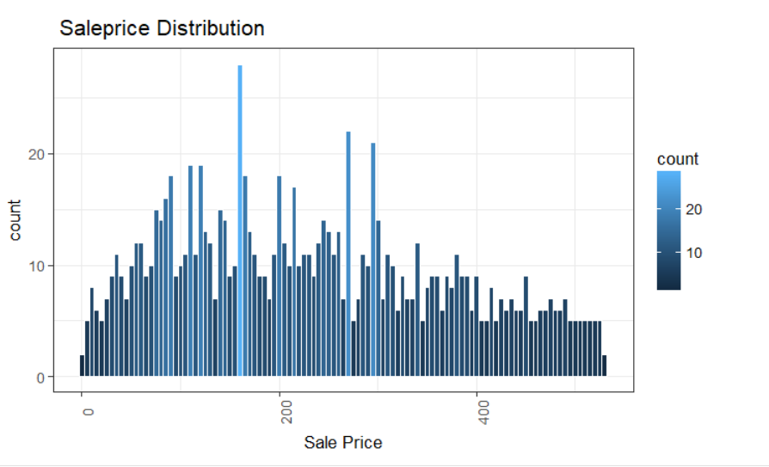

Slide 5
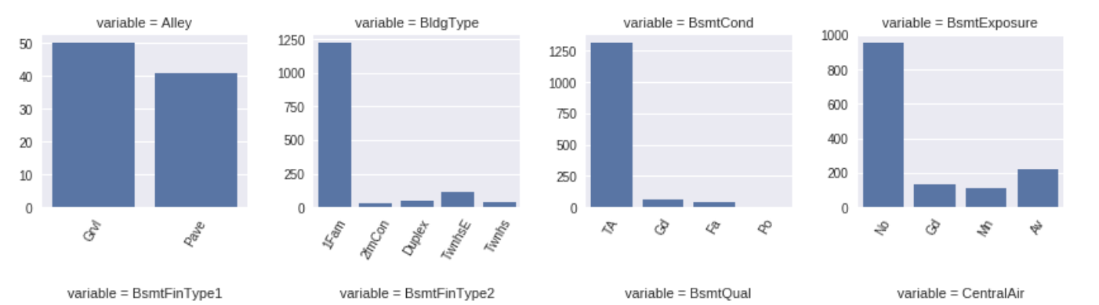
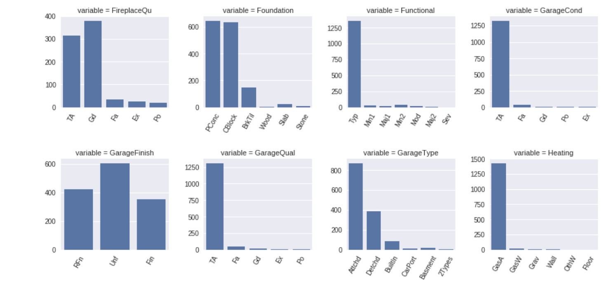
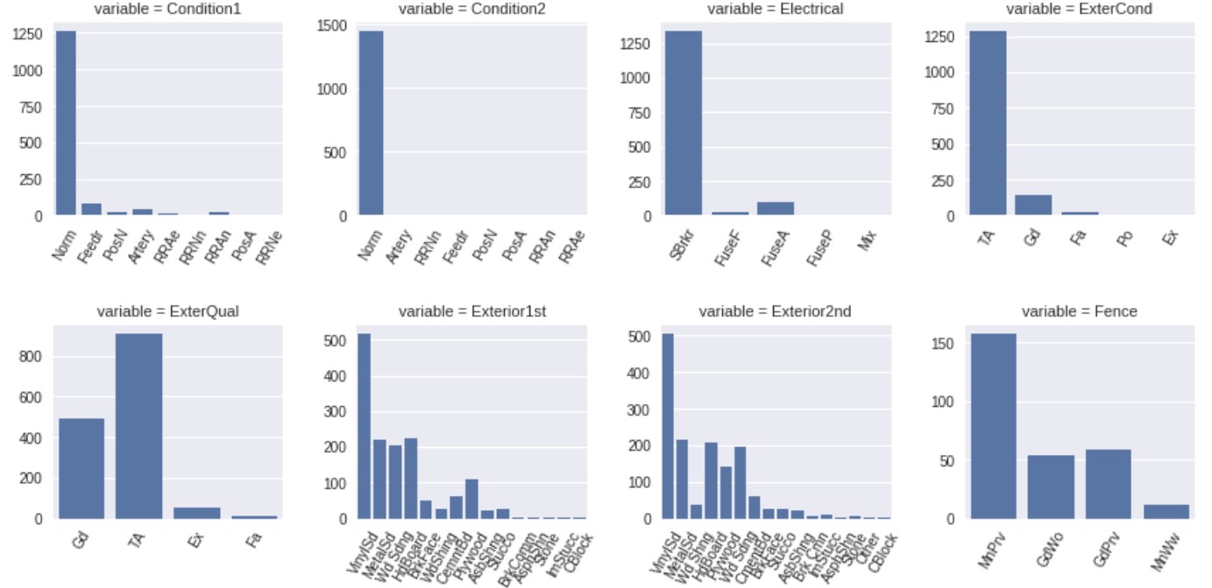
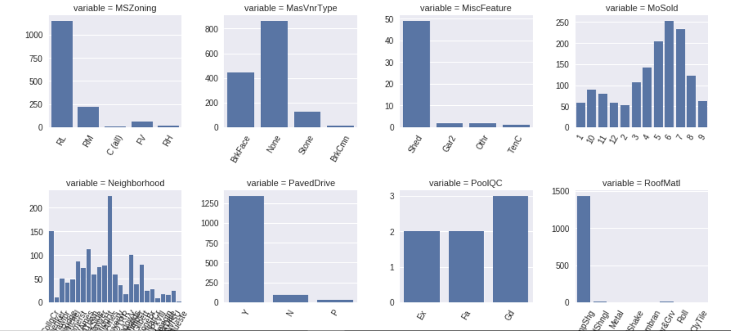
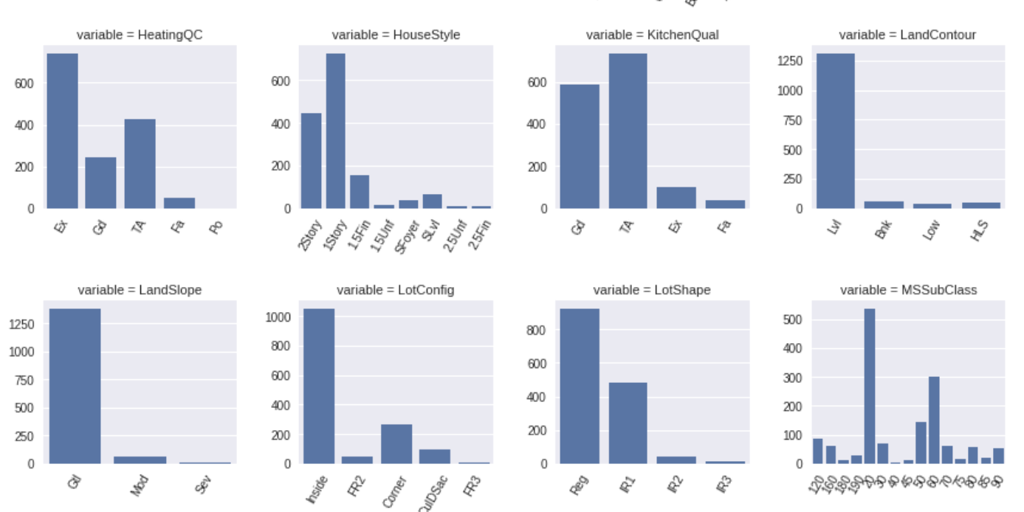

Slide 6
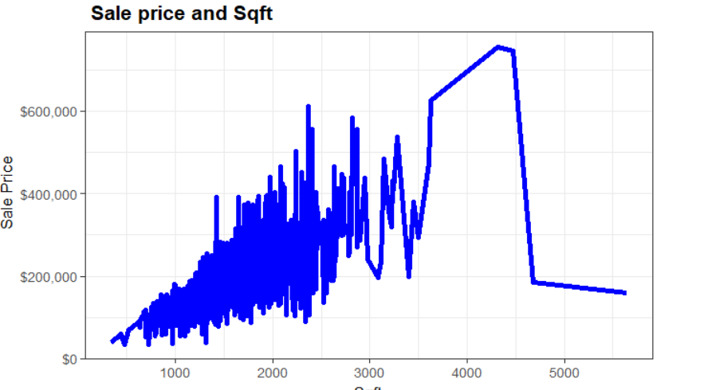
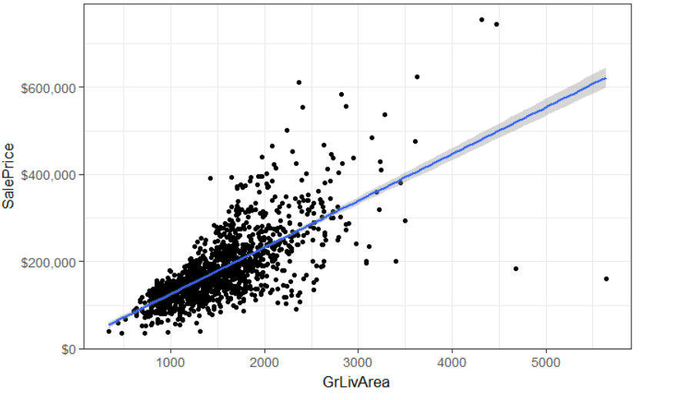
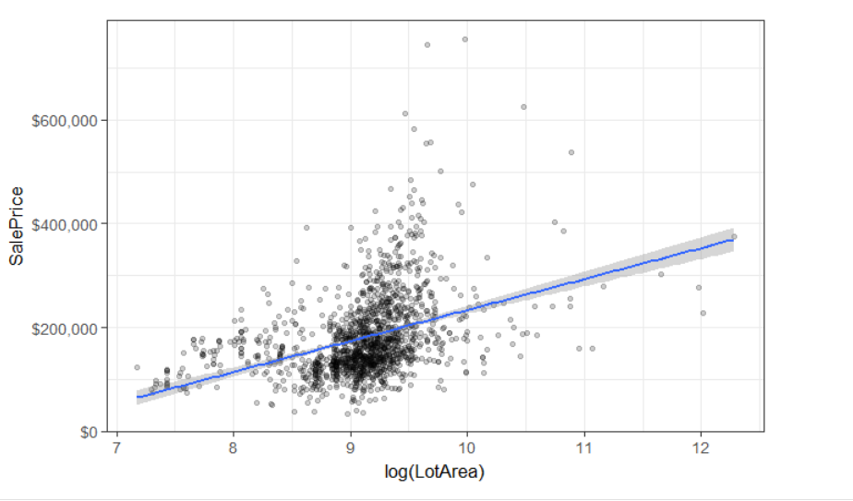
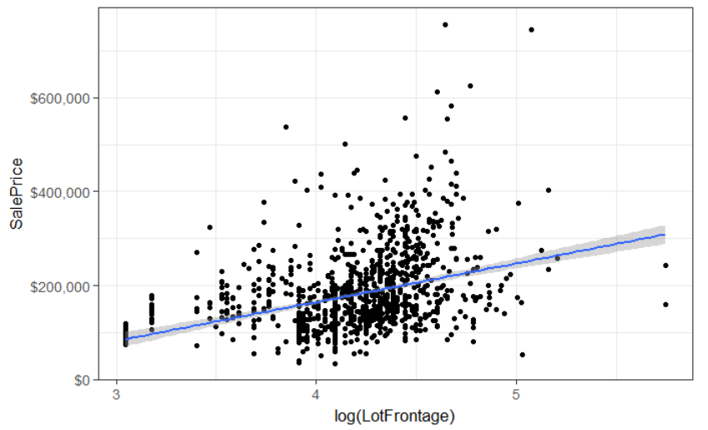

Slide 7
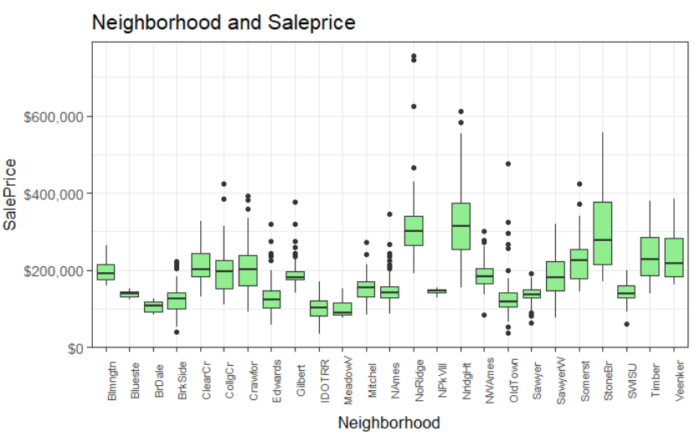
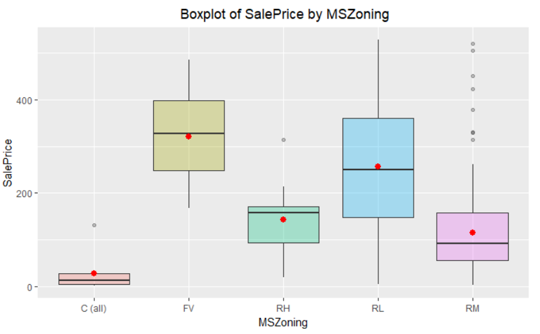
External and Internal elements relate to house price
External-Environment (neighborhood, zoning, building type)
Internal – Square feet, number of rooms

Slide 8
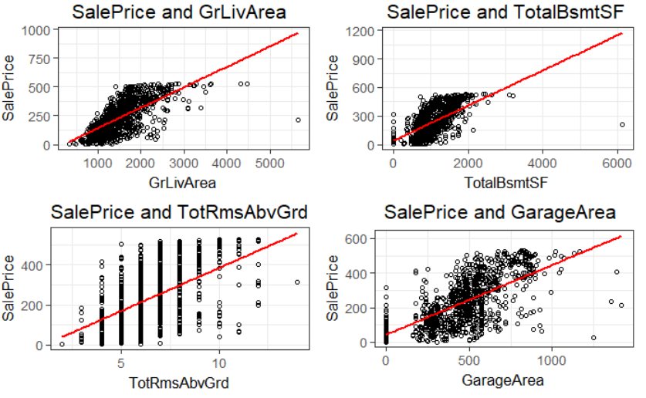

Slide 9
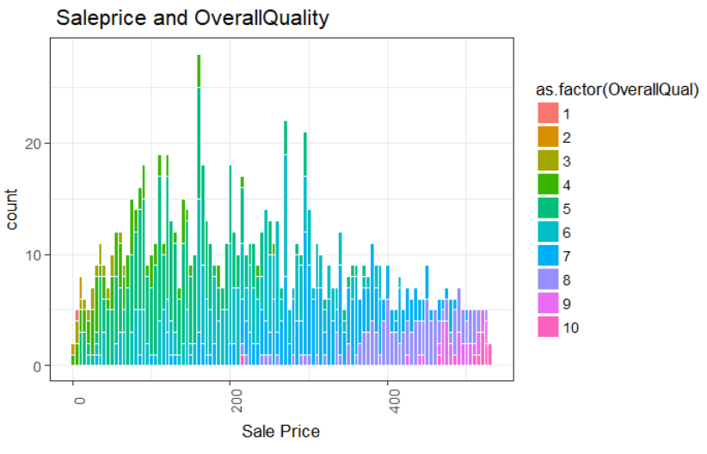

Slide 10
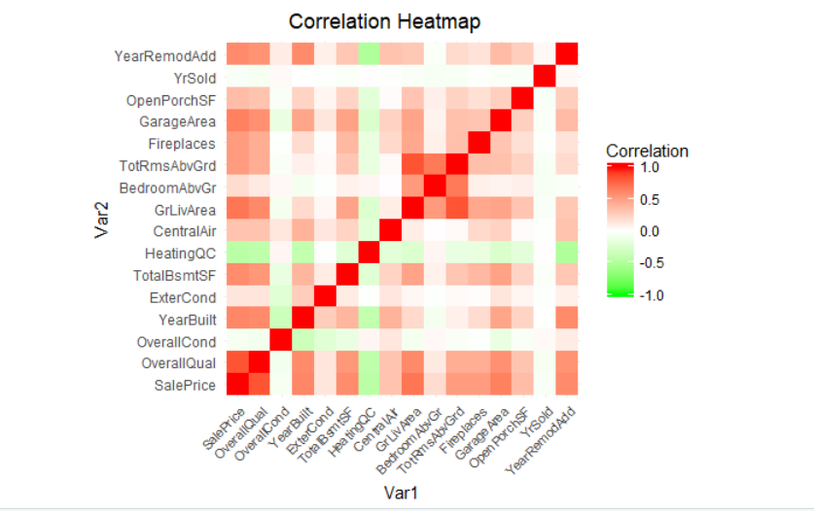

Slide 11
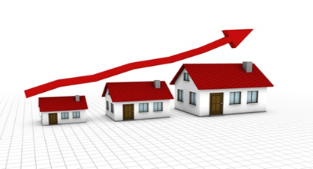
Exploration Result
Sale price increases with positively correlated values.
Size and quality of the house highly correlated with price.

Slide 12
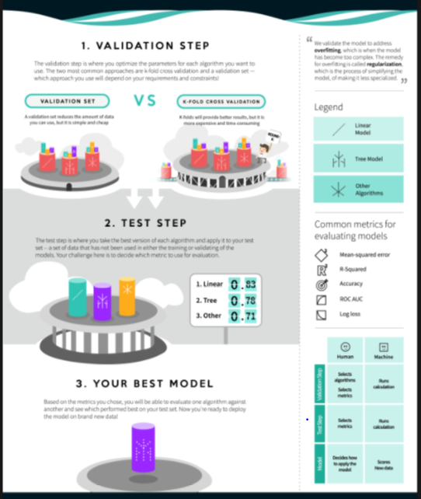
Analysis Method
Linear Regression Model
Classification & Regression Trees
Random Forest Model

Slide 13
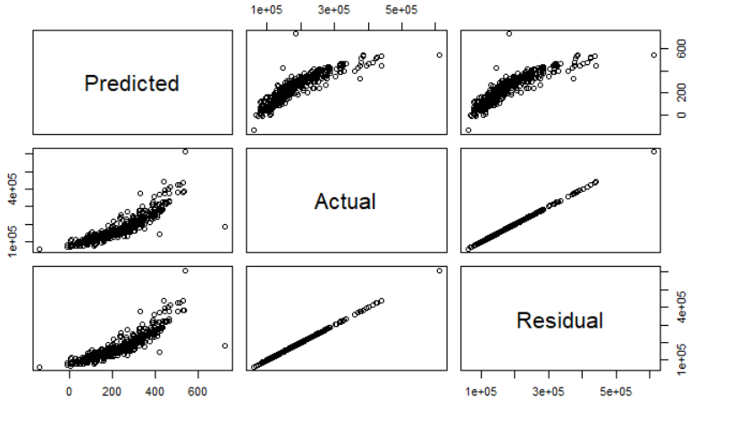
Linear Regression

Slide 14
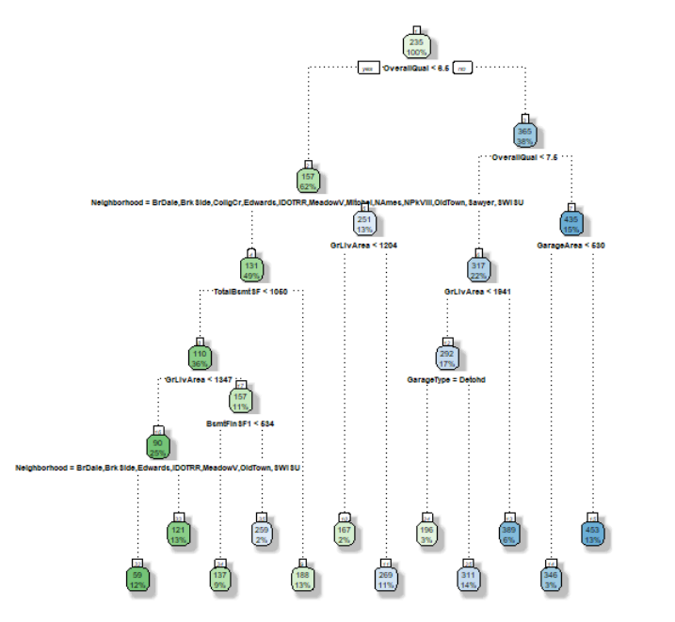
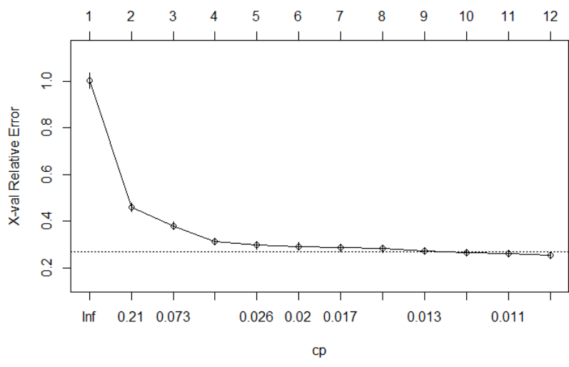
Tree Model

Slide 15
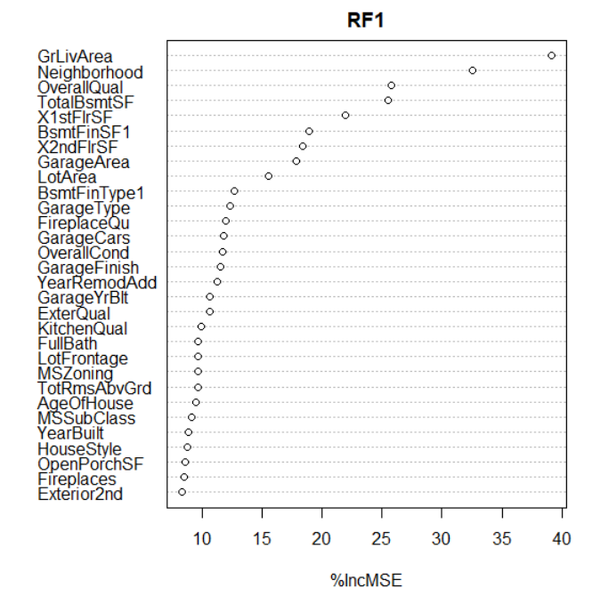
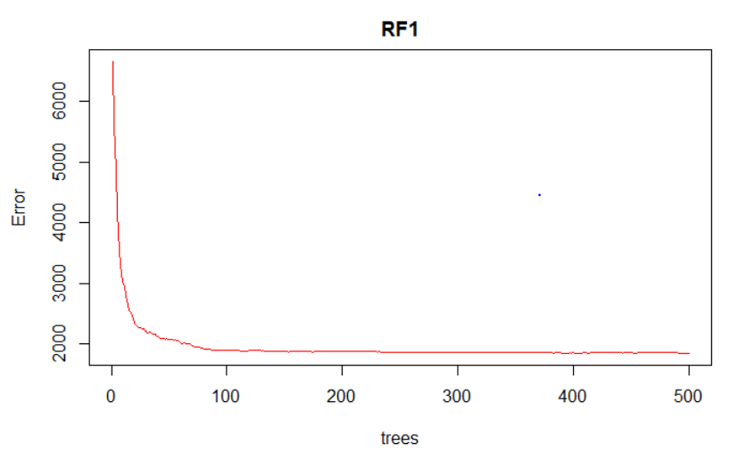
Random Forest
Important Variables

Slide 16
Model Comparison
Model | ME | RMSE | MAE | MPE | MAPE
Linear Regression | 180622 | 195097.9 | 180622 | 99.87421 | 99.87421
Classification &Regression Tree | 180618.6 | 195096 | 180618.6 | 99.87184 | 99.87184
Random Forest | 180619.3 | 195095.6 | 180619.3 | 99.87269 | 99.87269

Slide 17
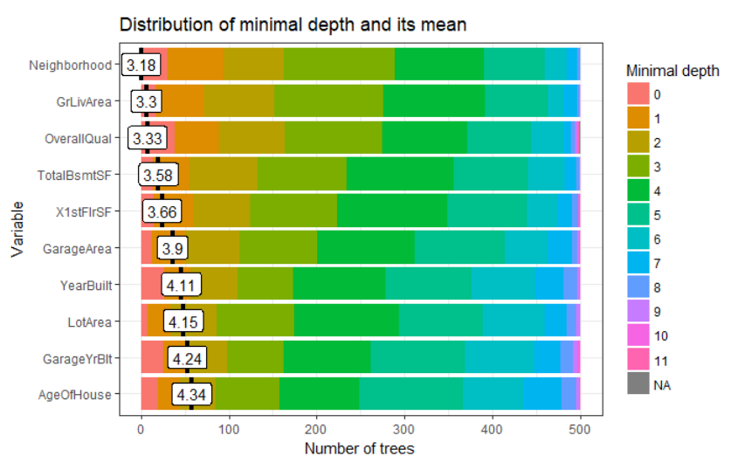
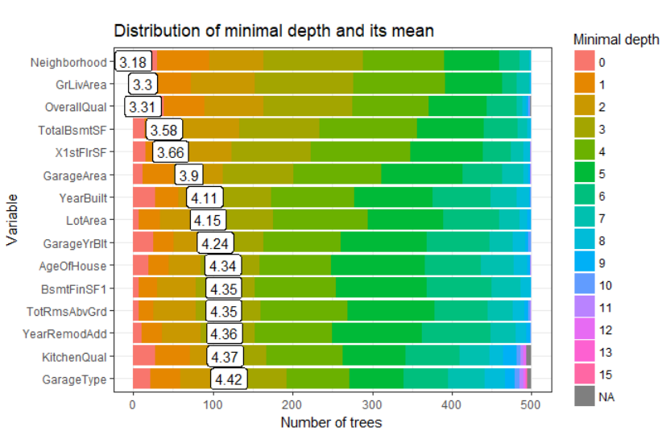
Random Forest
More Graphical representations of variable importance

Slide 18
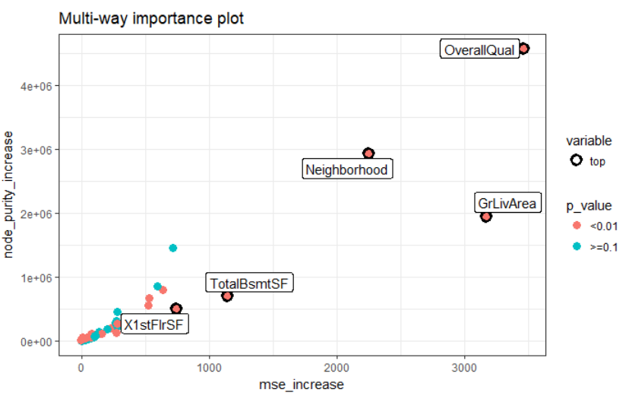

Slide 19
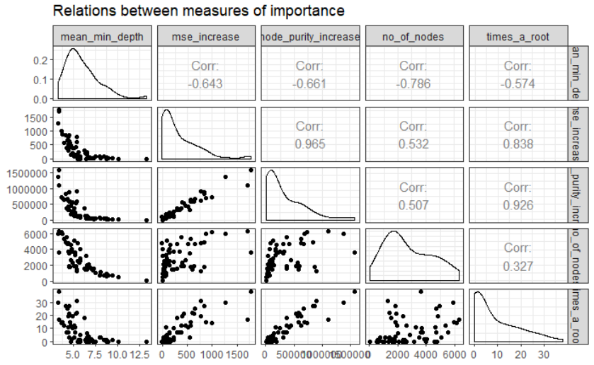
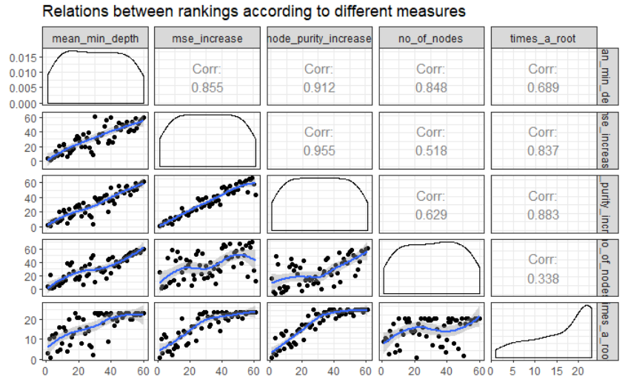

Slide 20
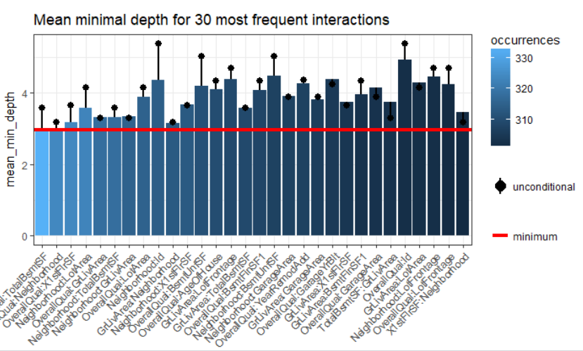
Five most important variables
OverallQual" "Neighborhood" "GrLivArea" "TotalBsmtSF" "X1stFlrSF“

Slide 21
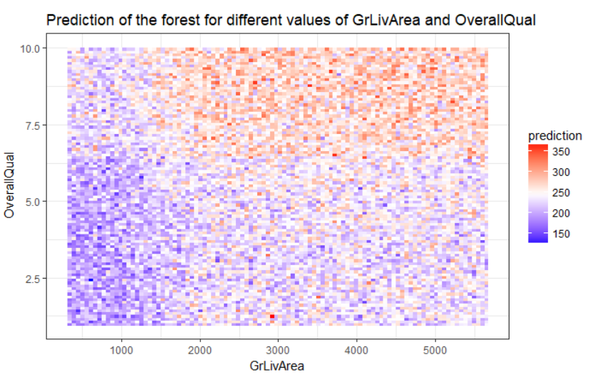

Slide 22
Prediction Summary
Summary | Min. | 1st Qu. | Median | Mean | 3rd Qu. | Max.
Train | 1.0 | 121.8 | 219.5 | 235.0 | 340.0 | 529.0
Linear Regression | -133.0 | 150.7 | 218.8 | 234.2 | 303.1 | 752.4
Tree | 58.63 | 136.97 | 196.14 | 237.64 | 310.96 | 452.98
Random Forest | 49.69 | 140.36 | 222.35 | 236.96 | 319.32 | 507.35

Slide 23
Analysis Result
Random forest predict the sale price better than other models
Measures impacts the house value are “ OverallQual" "Neighborhood" "GrLivArea" "TotalBsmtSF" "X1stFlrSF“
3 is related to the square footage of home ("GrLivArea" "TotalBsmtSF" "X1stFlrSF“)
Overall Quality, Location and square footage impacts the house value more.
A prospective new buyer and home owners or someone planning for a renovation focus more on quality of materials ,best rated neighborhoods and the more living SQFT makes a house better investment.

Slide 24
Assumptions, Limitations and Disclaimers
The results are only based on Iowa house price data.
Data only contains information of sales from 2006 to 2010. The real estate industry took a plunge in some of those years.
Important features like school rating, crime rating and how long the house was on market before sale and asking price are missing in the dataset.
Further exploration and analysis need to be done including missing features that influence the value in the data for ensuring the accuracy of results.

Slide 25
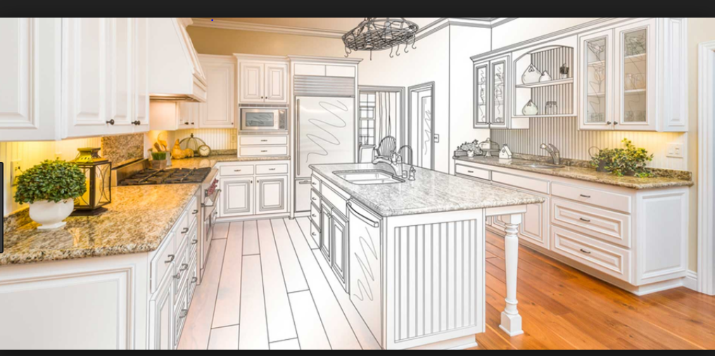
Thank You

